Slide 1
Improving
The
Grocery Shopping
Experience

Slide 2
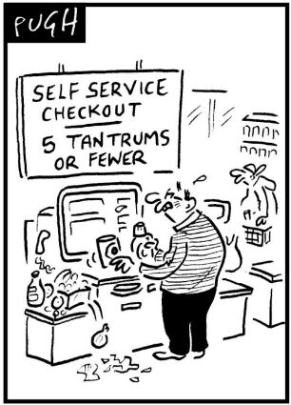
Pain Points
Long queues
Dysfunctional self-checkout machines
Incorrectly priced items
Finding exactly what you need
Forgetting that last-minute item

Slide 3
Goal/Solution
“To improve the grocery shopping experience through a mobile app”

Slide 4
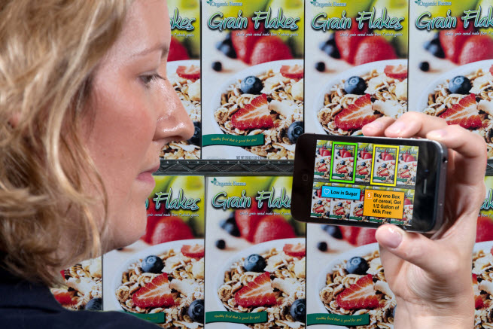
Prototype ideas: Scan capabilities
Allows users to scan bar as a way to checkout items
Skip the line

Slide 5
Prototype ideas: Live-interactions
Allows users to interact with store: see live discounts, product details

Slide 6
Notable features
(AR) Augmented Reality to provide real-time interaction with prices, deals, and finding what you need
Barcode/SKU scanning abilities to self-checkout items while they’re in your cart
Pay option: once ready for checkout
Voice-input recognition to break down items needed. E.g. “I’m gonna make spaghetti tonight” => app will list items needed and what aisles to find them

Slide 7
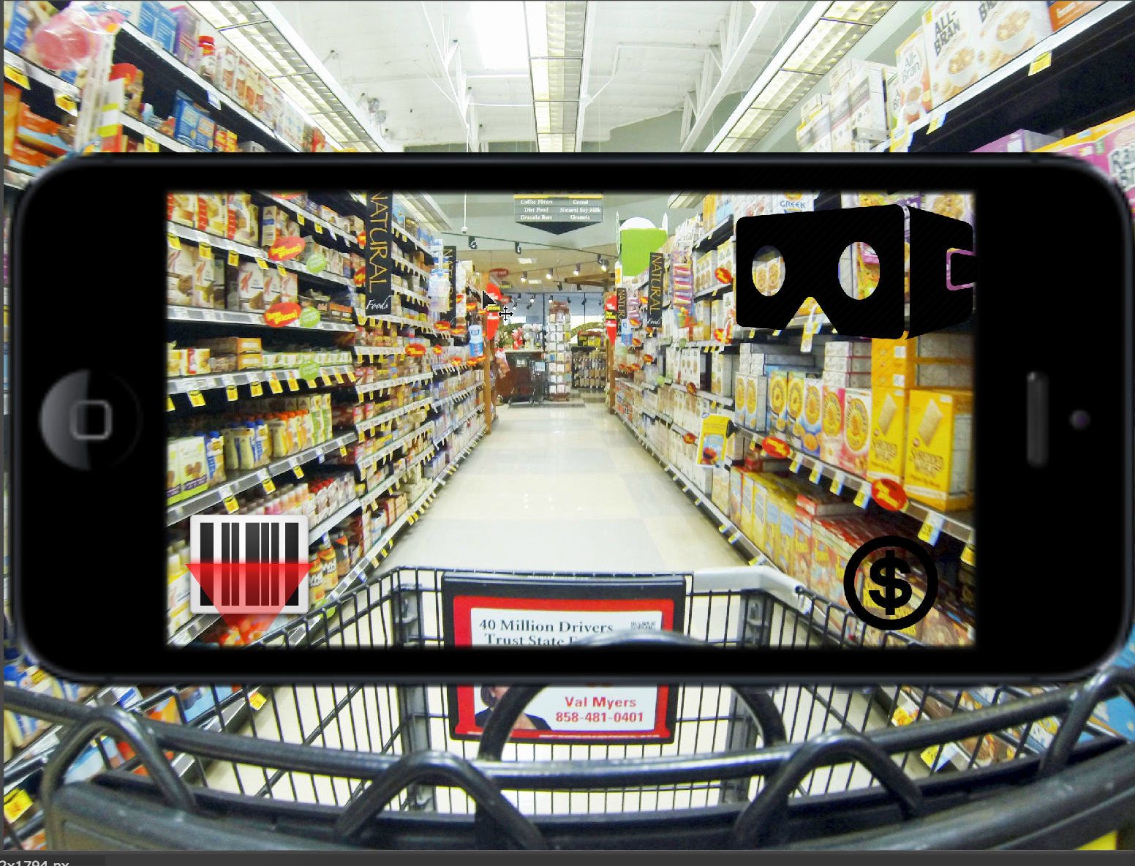
Lo-fidelity model

Slide 8
User-flow
Sign into app
Mount phone on shopping cart/hold phone to view through camera lense
Option: to scan items as they go in, or all at once
Option: Hit AR mode to view live-discounts/enable interactivity with store
Once done with shopping, hit “Pay” icon to pay groceries.

